Slide 1
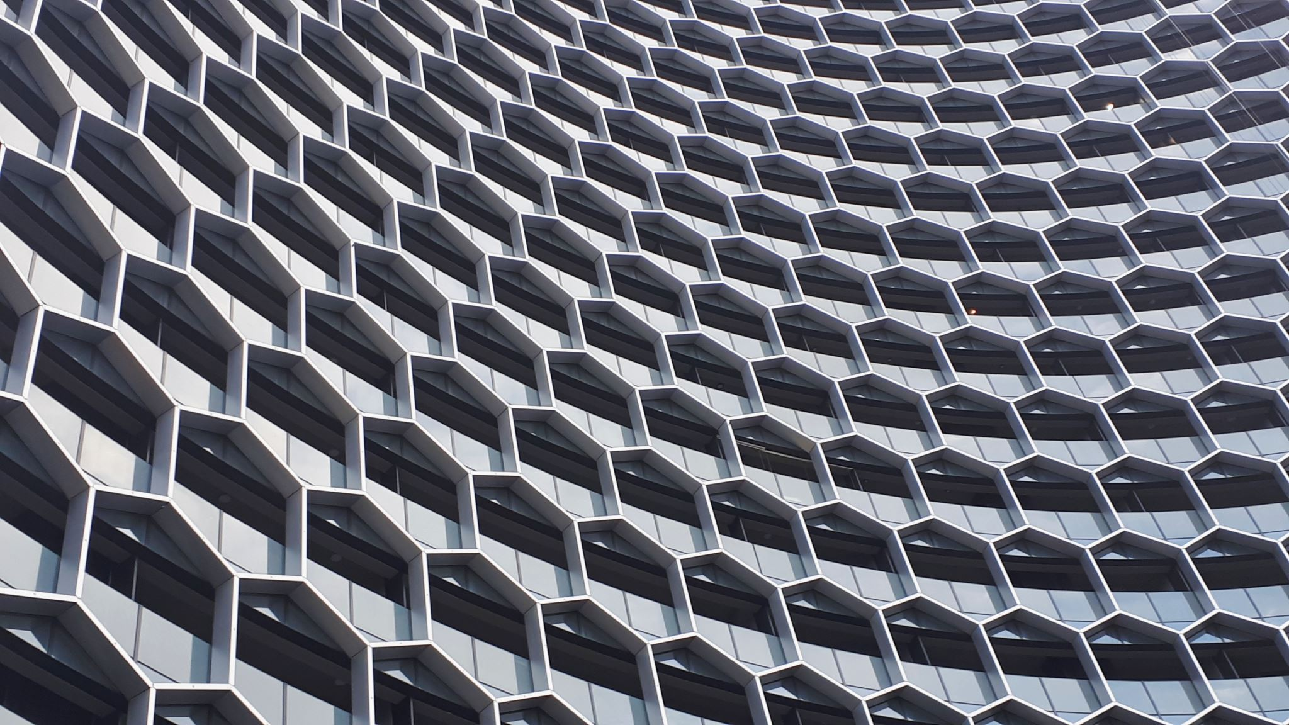
Modern Data Architecture Patterns

Slide 2
What is Medallion Architecture?
Medallion Architecture is a layered data design pattern used in modern data platforms to incrementally improve data quality, structure, and performance as data flows through the system.
It was popularized by Databricks as part of the Lakehouse approach.
Think of it as:
Raw → Clean → Business-ready

Slide 3
Core Layers of Medallion Architecture
Logical layering for data quality & governance
Often used inside lakehouse platforms
Layer | Purpose
Bronze | Raw ingested data
Silver | Cleaned & standardized
Gold | Business-ready aggregates

Slide 4
🥉 Bronze Layer (Raw Data)
Purpose: Ingest data as-is
Characteristics
Raw, unfiltered data
Source-aligned (Kafka, APIs, RDBMS, logs, files)
Schema-on-read
Append-only (no deletes/updates usually)
Examples
Kafka events
CDC data
JSON / CSV / Parquet files
Typical Operations
Basic ingestion
Metadata capture
Minimal validation
Goal: Data preservation & traceability

Slide 5
🥈 Silver Layer (Cleaned & Conformed Data)
Purpose: Clean, standardize, and enrich data
Characteristics
Deduplicated
Null handling
Type casting
Business keys applied
Joins across sources
Examples
Clean customer table
Valid transactions
Standardized timestamps & currencies
Typical Operations
Data quality rules
Schema enforcement
CDC merge (UPSERT)
Reference data joins
Goal: Reliable, analytics-ready data

Slide 6
🥇 Gold Layer (Business & Analytics Layer)
Purpose: Serve data for BI, ML, and reporting
Characteristics
Aggregated
Denormalized
Optimized for queries
Business logic applied
Examples
Daily sales metrics
Revenue by region
Customer lifetime value
Fact & dimension tables
Typical Operations
Aggregations
Window functions
KPI calculations
Star / Snowflake schemas
Goal: High-performance business insights

Slide 7
Source Systems
↓
🥉 Bronze (Raw)
↓
🥈 Silver (Cleaned & Conformed)
↓
🥇 Gold (Aggregated & Business Metrics)
↓
BI / Dashboards / ML Models

Slide 8
Why Medallion Architecture is Powerful
✅ Clear separation of concerns ✅ Easier debugging & replay ✅ Scales well with big data ✅ Supports batch + streaming ✅ Strong data governance ✅ Works perfectly with Delta / Iceberg / Hudi

Slide 9
Common Tools Used
Ingestion: Kafka, Kinesis, NiFi
Processing: Spark, Flink
Storage: Data Lake (S3, ADLS, GCS)
Table Formats: Delta Lake, Apache Iceberg
BI: Power BI, Tableau, Looker

Slide 10
2️⃣ Data Lake Architecture
Low-cost storage for raw, semi-structured & unstructured data
Core idea
Store everything first
Schema-on-read
Layers
Raw (Bronze)
Cleaned (Silver)
Curated (Gold)
Best for
Big data
ML workloads
Log, IoT, clickstream data
Cheap storage, flexible — but governance is hard

Slide 11
3️⃣ Lakehouse Architecture
Best of Data Lake + Data Warehouse
Core idea
Open data formats (Parquet, ORC)
ACID transactions on data lakes
One platform for BI + ML
Why it wins
No data duplication
Handles structured & unstructured data
Lower cost than DW-only approach
Best for
Analytics + ML together
Streaming + batch
Unified data platform
Industry default in 2024–2026

